Slide 1


Introduction to Data Structures and Algorithms
Data structures and algorithms are fundamental concepts in computer science and programming, essential for making applications more efficient. They involve the study of organizing and storing data, as well as developing efficient procedures to solve complex computational problems in real-time.
This presentation will explore various data structures, their applications, and associated algorithms. We'll also discuss the importance of these concepts in enhancing resource utilization and scalability in software development.
Hafiz Muhammad Tayyab Khushi

Slide 2
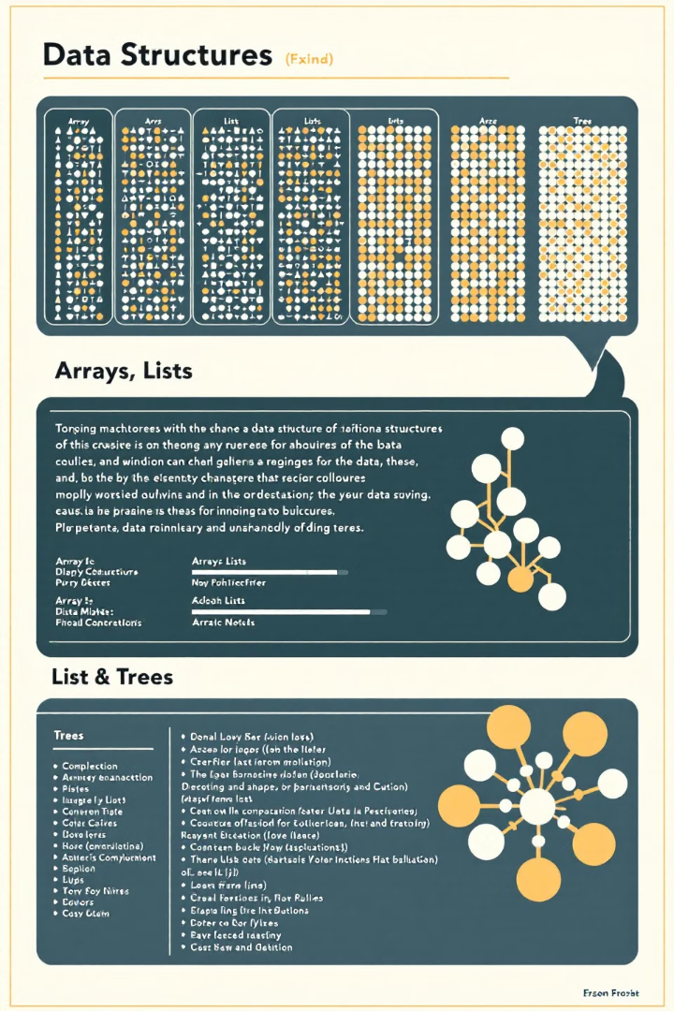
Understanding Data Structures
Definition
Purpose
Specialized formats for organizing, managing, and storing data efficiently
Enable efficient access and modification of data
Selection Criteria
Impact
Based on required operations like searching, sorting, inserting, deleting, or traversing
Correct choice can greatly enhance algorithm efficiency in terms of time and space complexity

Slide 3
Arrays: Fundamental Data Structure
Definition
Advantages
Applications
A group of elements stored in consecutive memory regions, all of the same data type, accessed using indexes.
Direct element access with O(1) time complexity. Suitable for static data storage.
Image processing, game development (e.g., chess board states), database management for fixed-size record storage.

Slide 4
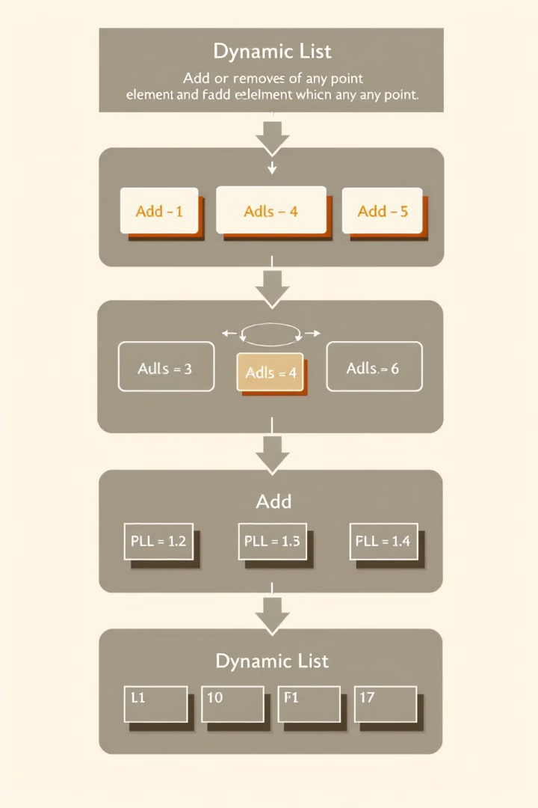
Lists: Flexible Data Storage
Key Features
Advantages
Mutable, sequential data structure capable of containing various data types. Dynamic size allows for growth or shrinkage as needed.
Flexible size, multi-type element storage, index-based access, and built-in functions for enhanced versatility.
Applications
E-commerce shopping carts, matrix representation,
database management for item collection storage in data analysis.

Slide 5




Linked Lists: Dynamic Linear Structure
Structure
Advantages
Applications
Linear organization of elements (nodes), each containing a value and a reference to the next node.
Dynamic size, efficient insertions and deletions at any position.
Music playlists,
undo/redo operations in text editors, dynamic memory management.

Slide 6
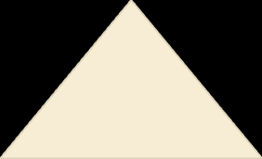


Stacks: Last In, First Out (LIFO)
LIFO Principle
1
Last added element is removed first
Simple Implementation
2
Efficient push and pop operations
Function Call Management
3
Efficient handling of call stacks
Applications include expression evaluation in compilers, backtracking algorithms like Depth First Search (DFS), and function call management in programming languages.

Slide 7
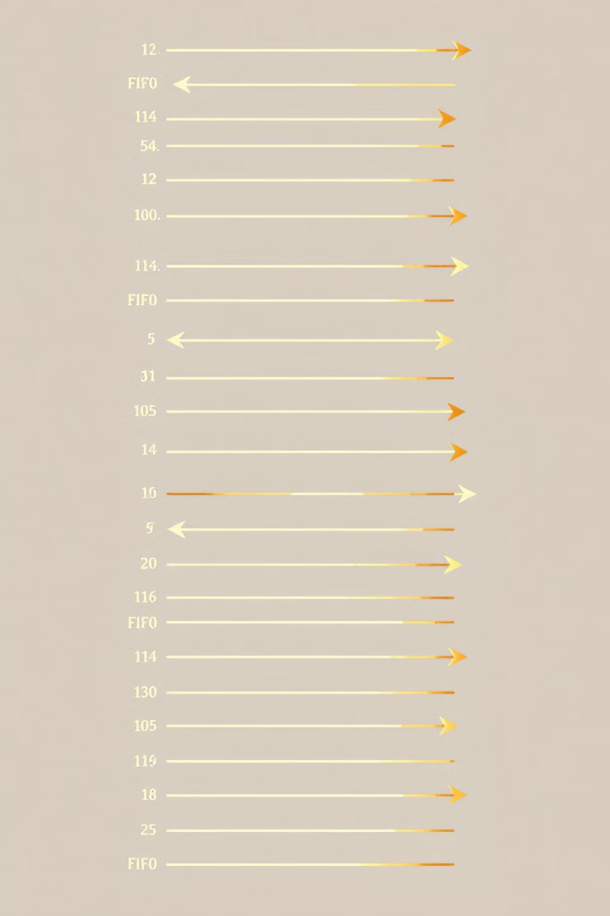
Queues: First In, First Out (FIFO)
1
FIFO Principle
First element added is the first to be removed
2
Order Maintenance
Ensures first-come, first-served order
3
Task Scheduling
Suitable for scheduling and buffering tasks
Queues are widely used in operating systems for CPU task scheduling, managing service requests, and in graph traversal algorithms like Breadth First Search (BFS).

Slide 8




Trees: Hierarchical Data Organization
Structure
Efficiency
Hierarchical organization of nodes, each containing a value and child nodes
Effective for searching, inserting, and deleting data, especially in binary search trees
Natural Representation
Displays hierarchical relationships intuitively
Trees are extensively used in file systems,
decision-making models in AI and machine learning, and database indexing for quick data retrieval.

Slide 9
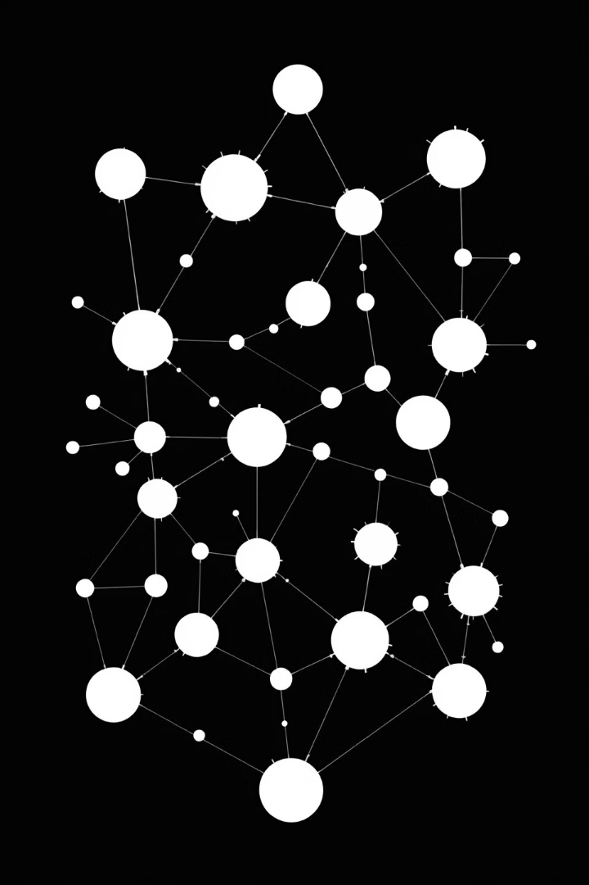
Graphs: Complex Relationship
Modeling
Definition
Advantages
A set of nodes (vertices) connected by edges, which can be directed or undirected.
Efficient for modeling complex relationships and finding shortest paths or network connectivity.
Applications
Social media networks, recommendation systems, and mapping services like Google Maps for path finding.

Slide 10
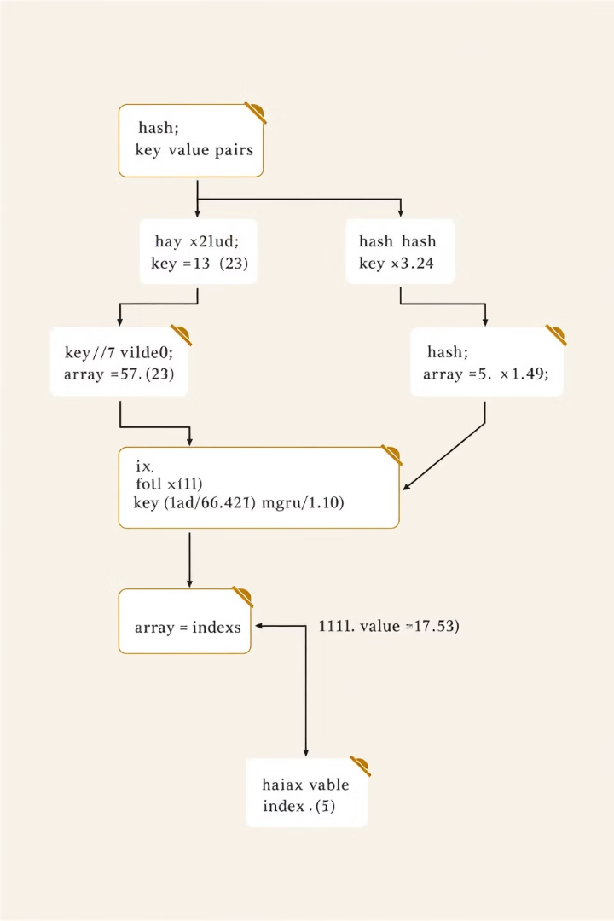
Hash Tables: Efficient Key-Value Storage
Structure
Advantages
Contains key-value pairs, using a hash function to calculate an index for data storage and retrieval.
Fast data retrieval and efficient for large datasets with frequent lookups.
Applications
Database indexing, web caching mechanisms, and symbol tables in compilers.

Slide 11
Heaps: Specialized Tree-Based Structure
Heap Property
1
Parent nodes are greater (max-heap) or smaller (min-heap) than child nodes
Priority Operations
2
Support priority-based operations efficiently
Efficient Access
3
Quick access to maximum or minimum element
Heaps are commonly used in priority queues for task scheduling based on priority and in shortest path algorithms like Dijkstra's Algorithm.

Slide 12
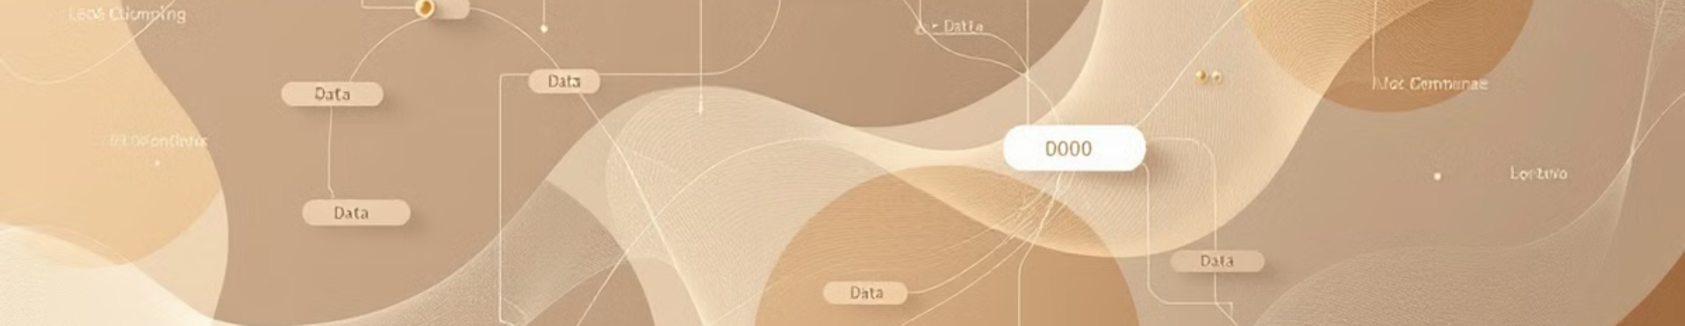
Introduction to Algorithms
Algorithms are step-by-step procedures or formulas for solving problems. They operate on data structures to perform various tasks, such as searching, sorting, and optimization. Understanding algorithms is crucial for efficient problem-solving in computer science.
Purpose
Interaction
Variety
Solve complex computational problems efficiently
Work in conjunction with data structures
Different types for various tasks and problem domains

Slide 13
Sorting Algorithms: Organizing Data
Purpose
Common Types
Applications
Organize data in a specific order (ascending or descending)
Quicksort, Merge Sort, Bubble Sort
Database management, search optimization, data analysis

Slide 14

Searching Algorithms: Finding Elements
Linear Search
Binary Search
Applications
Sequentially check each element in the collection
Efficient for sorted data, divides search interval in half repeatedly
Database queries, file systems, AI and machine learning

Slide 15
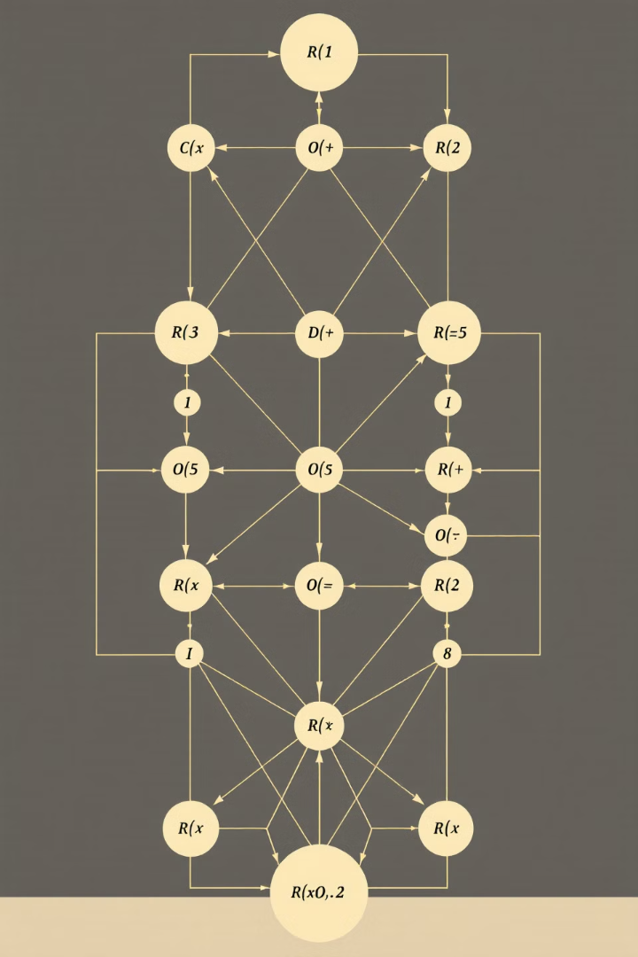
Dynamic Programming: Optimizing Complex Problems
Concept
Technique
Solve complex problems by breaking them into simpler subproblems
Store solutions to subproblems to avoid redundant computations
Applications
Optimization problems, sequence alignment in bioinformatics, resource allocation

Slide 16
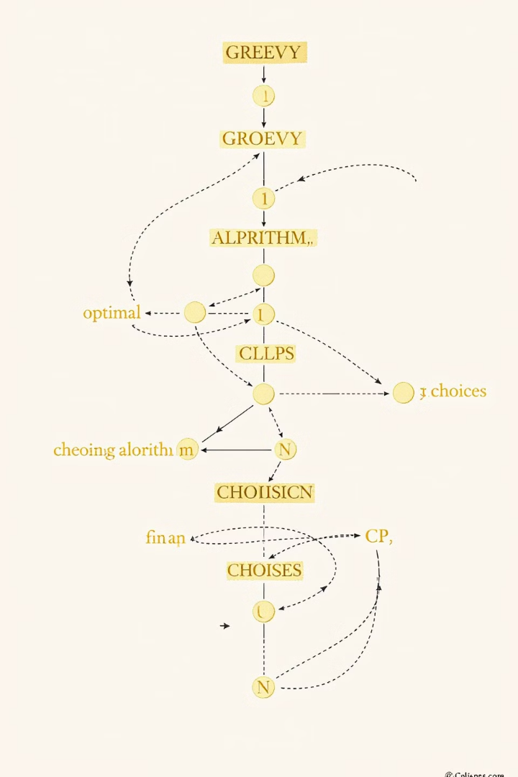
Greedy Algorithms: Making Optimal Choices
1
Principle
Make locally optimal choices at each stage
2
Goal
Find a global optimum through a series of local optima
3
Applications
Huffman coding, Dijkstra's shortest path, scheduling problems

Slide 17




Graph Algorithms: Navigating Complex Networks
Depth-First Search (DFS)
Breadth-First Search (BFS)
Explores as far as possible along each branch before backtracking
Explores all neighbor nodes at the present depth before moving to nodes at the next depth level
Shortest Path Algorithms
Dijkstra's and Bellman-Ford algorithms for finding optimal routes

Slide 18
Divide and Conquer: Breaking Down Problems
Divide
1
Break the problem into smaller subproblems
Conquer
2
Solve subproblems recursively
Combine
3
Merge solutions to solve the original problem
This approach is used in algorithms like Merge Sort, which breaks down the sorting problem into smaller parts, sorts them, and then combines the results.

Slide 19
Importance of Data Structures and Algorithms
Resource Optimization
Scalability
Problem-Solving
Enhance utilization of time and space, resulting in efficient data management and faster processing in applications.
Efficient algorithms and optimized data structures ensure applications can handle larger data sizes without performance issues.
Provide frameworks for solving complex computational problems effectively across various domains.

Slide 20

Conclusion: Mastering Data Structures and Algorithms
Foundation of Computer Science
Continuous Learning
Essential knowledge for any programmer or software engineer
Field evolves with new structures and algorithms for emerging problems
Practical Application
Career Advancement
Critical for developing efficient, scalable software solutions
Proficiency often required for technical interviews and senior roles

